Slide 1
Conceptual Dynamics
Part II: Kinematics of Particles
Chapter 3
Kinematics of Particles
Plane Curvilinear Motion
Constrained & Dependent Motion

Slide 2
Constrained & Dependent Motion

Slide 3
Constrained & Dependent Motion
What is Constrained Motion?

Slide 4
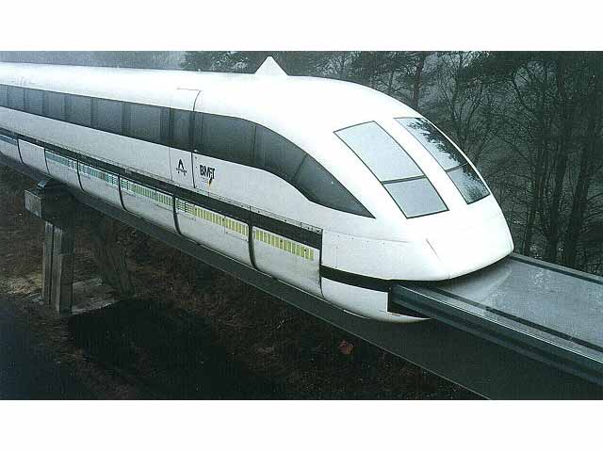
Constrained & Dependent Motion
What is Constrained Motion?
The train is constrained to move along the track. When a particle is forced to move in a particular direction.

Slide 5
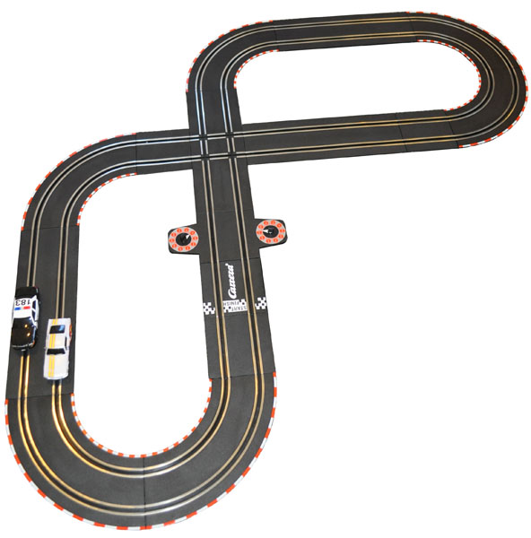
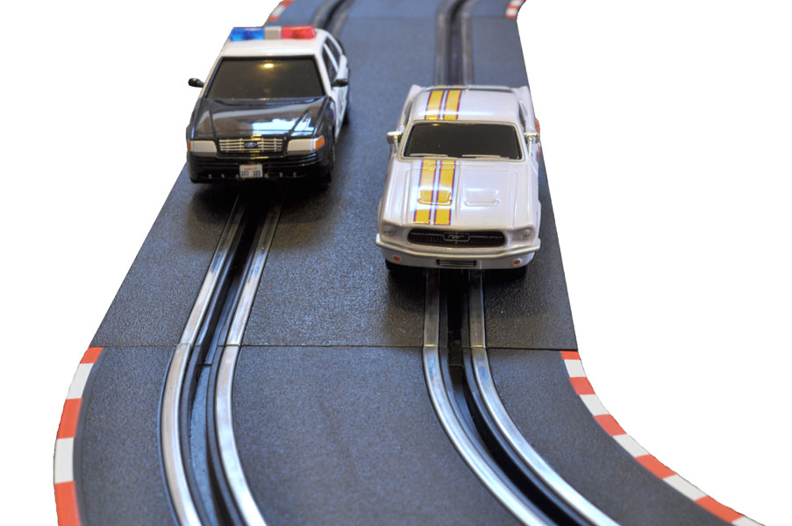
Constrained Motion
Slot cars are an example of constrained motion.

Slide 6
Constrained & Dependent Motion
What is Dependent Motion?

Slide 7
Constrained & Dependent Motion
What is Dependent Motion?
One particle is dependent on the motion of another. There is a motion relationship between them.

Slide 8
Rope & Pulley systems

Slide 9
Dependent Motion
Video
Eureka! The Pulley (Start at 0:30)

Slide 10
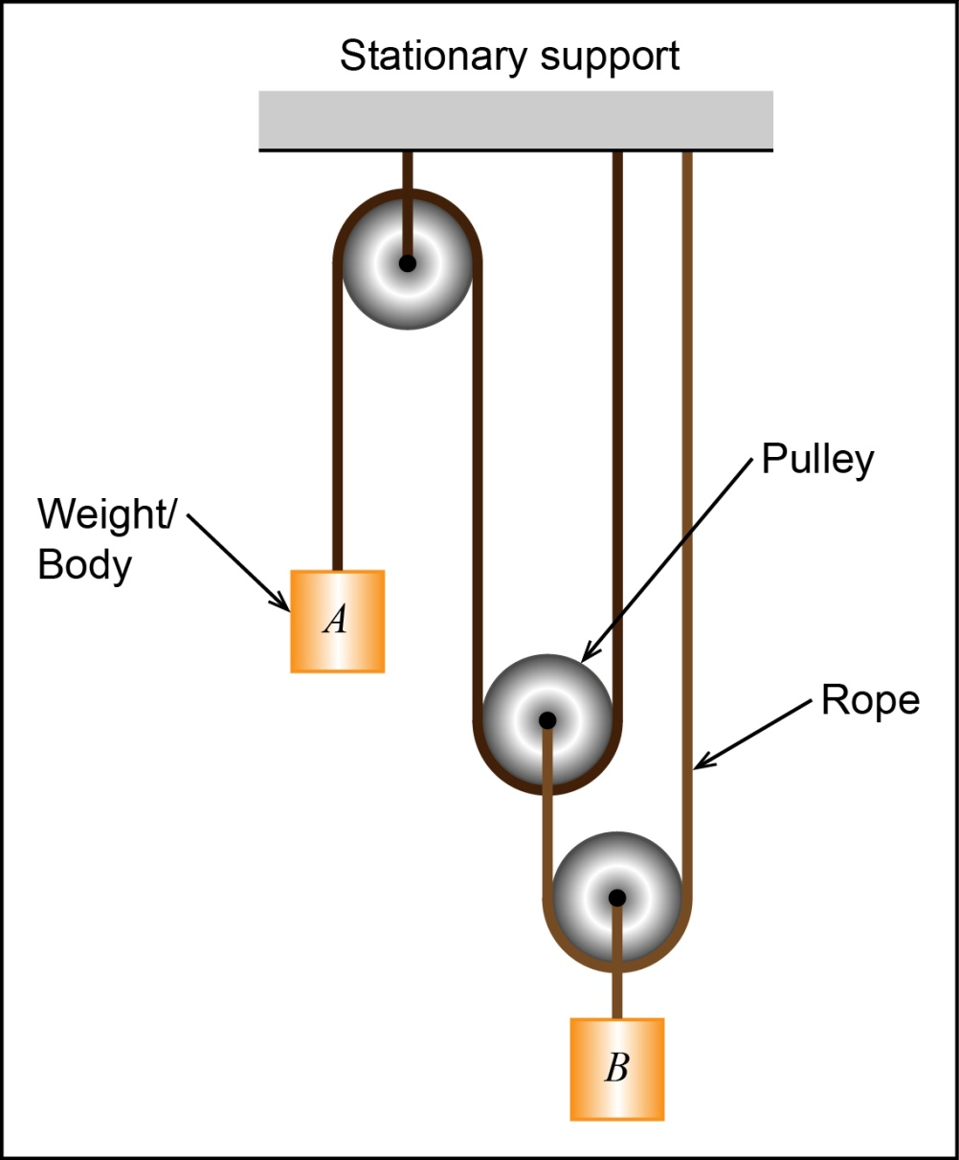
Rope & Pulley Problems
If A moves, will B move? Why?

Slide 11
Rope & Pulley Problems
If A moves, will B move? Why?
The motion of B is dependent on the motion of A.

Slide 12
Rope & Pulley Problems
Did B move faster or slower than A? Why?

Slide 13
Rope & Pulley Problems
Did B move faster or slower than A? Why?
B moved slower than A.

Slide 14
Solving a Rope & Pulley Problem
Step 1) Choose a datum(s):
A datum line is fixed.
Used as an origin to measure distances.
One datum for every direction of motion.

Slide 15
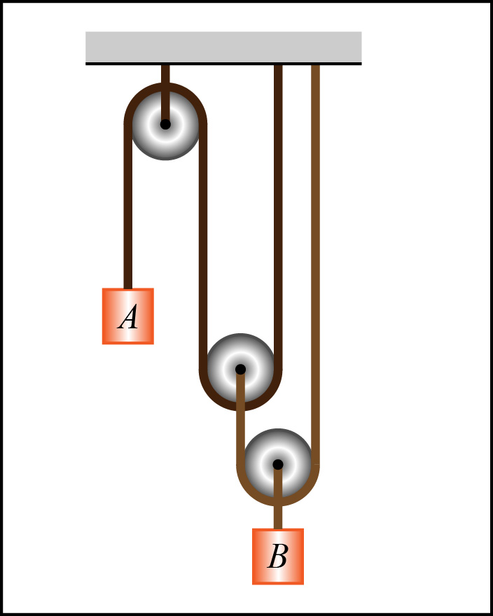
Example 3.7-1
Step 1) Choose a datum(s):

Slide 16
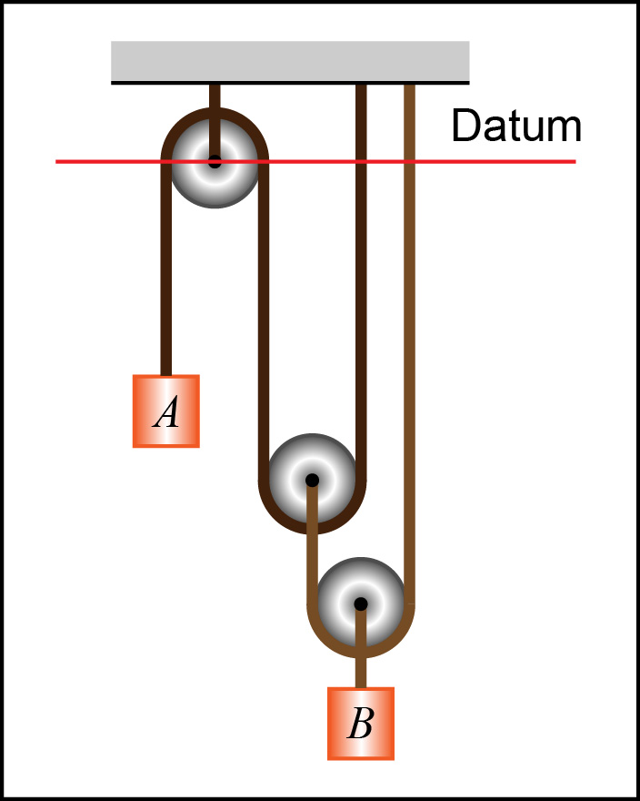
Example 3.7-1
Step 1) Choose a datum(s):

Slide 17
Solving a Rope & Pulley Problem
Step 2) Position coordinates:
Measure the distances from the datum to each moving particle.

Slide 18
Example 3.7-1
Step 2) Position coordinates:

Slide 19
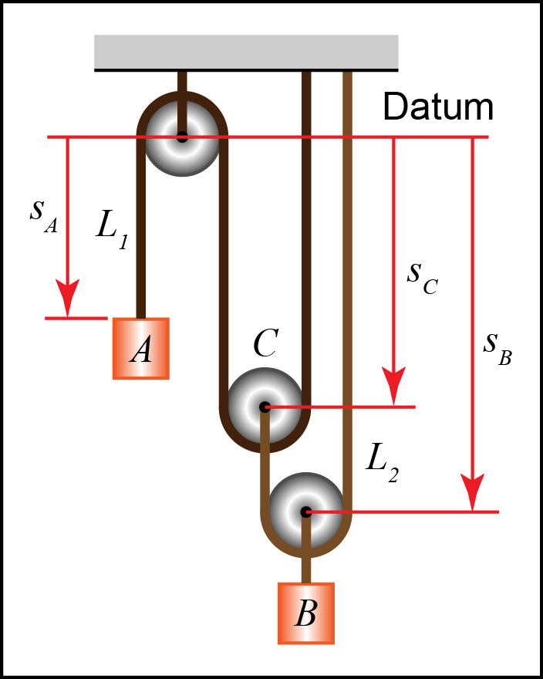
Example 3.7-1
Step 2) Position coordinates:

Slide 20
Solving a Rope & Pulley Problem
Step 3) Rope lengths:
Write down the length of each rope in terms of the position coordinates.
Note: The number of ropes = degrees of freedom

Slide 21
Example 3.7-1
Step 3) Rope lengths:

Slide 22
Example 3.7-1
Step 3) Rope lengths:

Slide 23
Example 3.7-1
Step 3) Rope lengths:

Slide 24
Solving a Rope & Pulley Problem
Step 4) Time derivatives:
Take the time derivative of the length equation to obtain the velocity and acceleration equations.

Slide 25
Example 3.7-1
Step 4) Time derivatives:

Slide 26
Solving a Rope & Pulley Problem
Step 5) Solve and verify:
Solve the problem and make sure that the answers make sense in terms of the signs and magnitudes.

Slide 27
Example 3.7-1
Step 5) Solve and verify:
Solve the problem and make sure that the answer makes sense in terms of the signs and magnitudes.

Slide 28
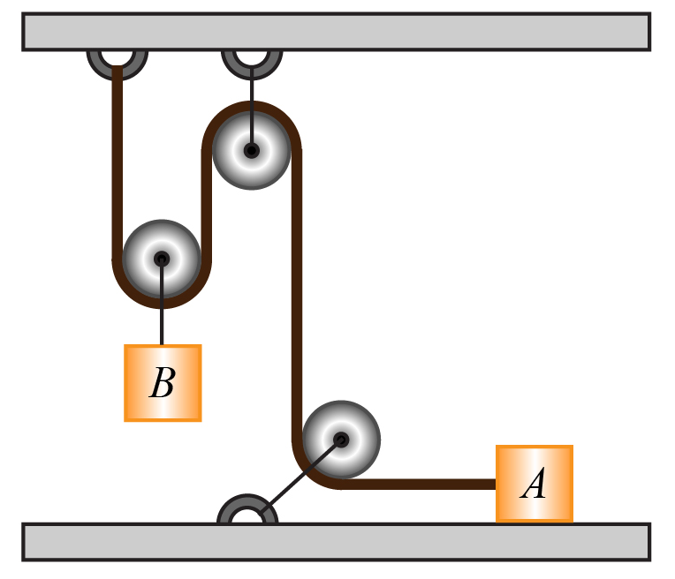
Example 3.7-2
Choose a datum(s)

Slide 29
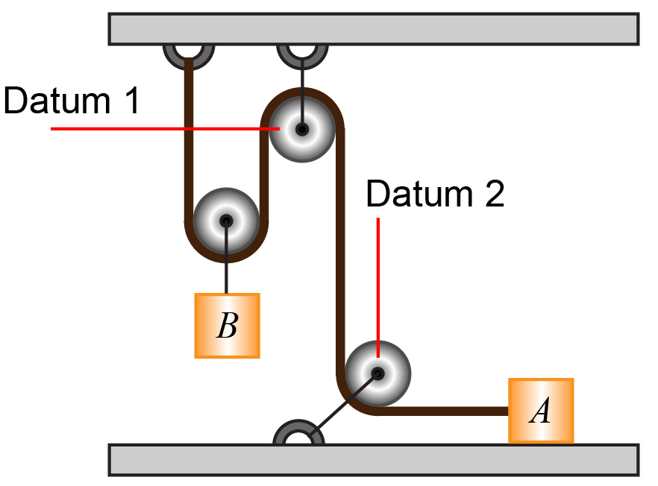
Example 3.7-2
Choose a datum(s)

Slide 30
Example 3.7-2
Add position coordinates

Slide 31
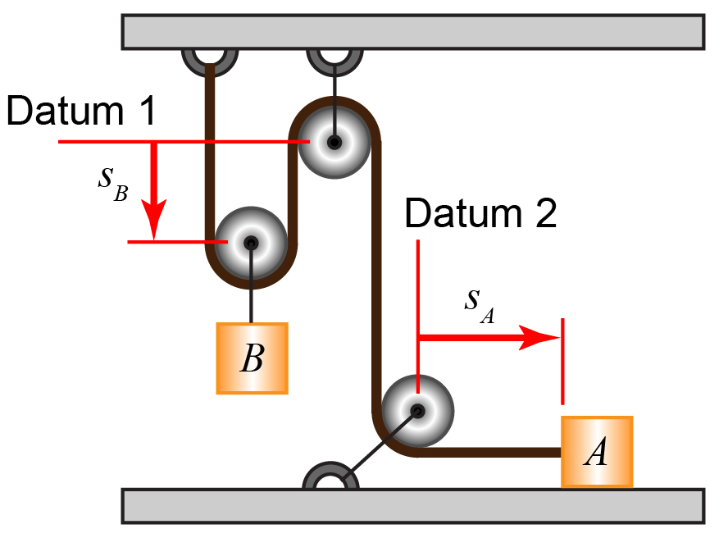
Example 3.7-2
Add position coordinates

Slide 32
Example 3.7-2
Coordinate position equation

Slide 33
Example 3.7-2
Coordinate position equation

Slide 34
Example 3.7-2
Time derivatives

Slide 35
Example 3.7-2
Time derivatives
0

Slide 36
Dependent Motion Problem
Does the answer make sense?

Slide 37
Example Problems
EP3.7-3

Slide 38
Linear Bearings and Collars

Slide 39
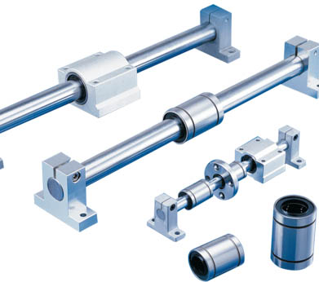
Linear Bearings and Collars
Constrain the motion along a shaft.

Slide 40
Slots

Slide 41
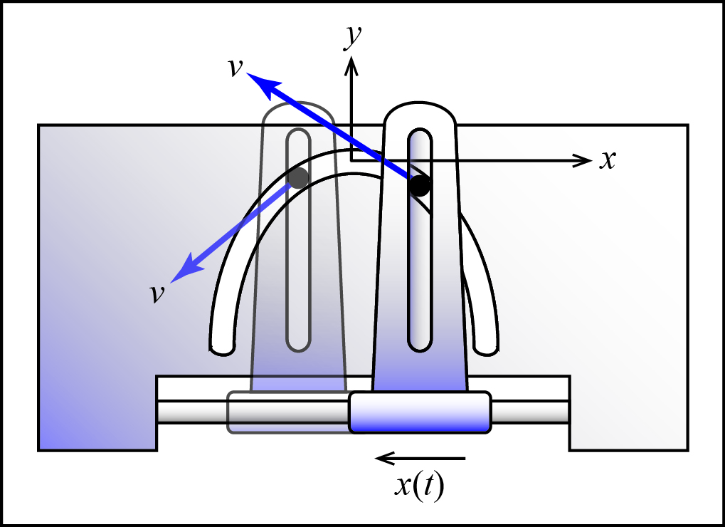
Slots
Constrain the motion along a slot.
Velocity is always tangent to the slot path.

Slide 42
Joints

Slide 43
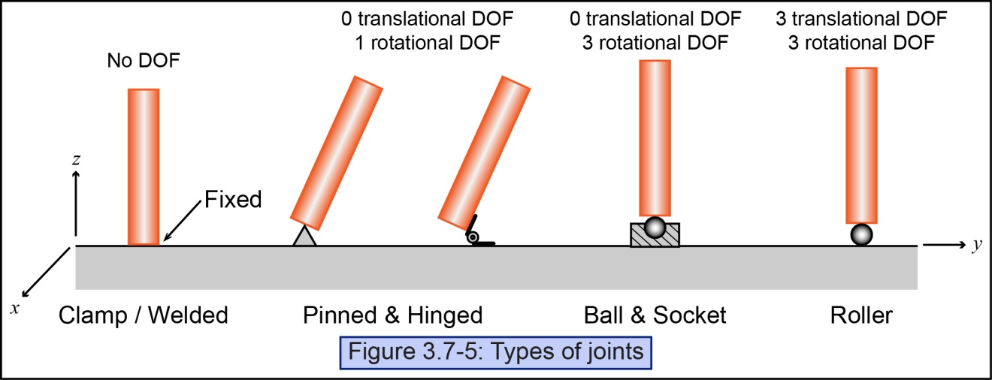
Joints
Different joints constrain motion in different ways.

Slide 44
Surface Contacts / Cam and Follower

Slide 45
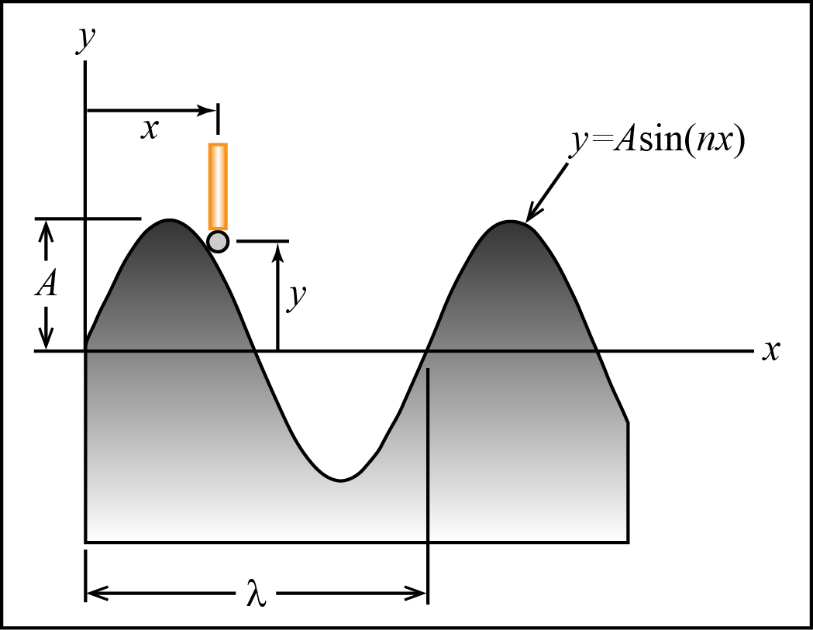
Surface Contact
The motion of the particle in contact with the surface is dependent on the surface profile.
Position
dependence
Velocity
dependence

Slide 46
Cam and Follower

Slide 47
Cam and Follower

Slide 48
Example Problems
EP3.7-4

